Slide 1
GRADE 7 ACCELERATED · UNIT 2 · LESSON 1
Square Values
MA.8.AR.2.3
I can square a number, find the side of a square from its area, and explain the graph of y = x².
A new unit, and a new benchmark.
Today everything is a square you could draw.
Grade 7 Accelerated · Unit 2 · Lesson 1 — Square Values
1

Slide 2
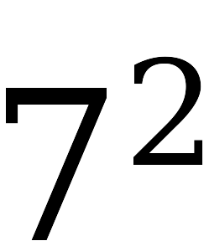
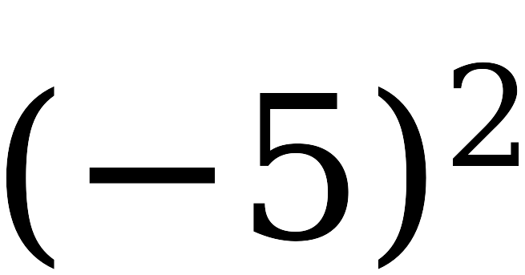
Warm-Up
On your own. Four minutes.
Same and different
What is the same about these two, and what is different?
Grade 7 Accelerated · Unit 2 · Lesson 1 — Square Values
2

Slide 3
Notes
I. Squaring means multiplying a number by itself
A.
square (a number) — to multiply the number by itself
B.
5 squared = 5² = 5 × 5 = 25.
C.
It is NOT 5 × 2. Squaring and doubling are different operations.
Grade 7 Accelerated · Unit 2 · Lesson 1 — Square Values
3

Slide 4
Notes
II. The perfect squares, to 225
A.
perfect square — a number you get by squaring a whole number
B.
1, 4, 9, 16, 25, 36, 49, 64, 81, 100, 121, 144, 169, 196, 225
C.
Know these on sight. Every question in this unit is answered faster if you do.
Grade 7 Accelerated · Unit 2 · Lesson 1 — Square Values
4

Slide 5
Notes
III. A square's area runs both ways
A.
Four equal sides, so the area is A = s × s = s².
B.
Side to area: s = 6 gives A = 6² = 36 square units.
C.
Area to side: A = 36 means s × s = 36, so s = 6 units.
D.
Backwards is the harder direction. Ask: what number times itself gives this?
Grade 7 Accelerated · Unit 2 · Lesson 1 — Square Values
5

Slide 6
Notes
IV. Squaring never gives a negative answer
A.
A positive times itself is positive. 3 × 3 = 9.
B.
A negative times itself is positive. (−3) × (−3) = 9.
C.
So opposite x-values give the SAME y-value, and y is never negative.
D.
The graph of y = x² never goes below the x-axis. At x = 0 it touches it.
Grade 7 Accelerated · Unit 2 · Lesson 1 — Square Values
6

Slide 7

Example 1
Nothing on paper yet. Answer out loud.
Kind of number
Side s
What will you do?
whole number
12 units
fraction
decimal
0.7 units
Same operation three times. Say what changes.
Grade 7 Accelerated · Unit 2 · Lesson 1 — Square Values
7

Slide 8
Example 1
Now the areas. Whiteboards.
Kind of number
Side s
Area s²
whole number
12 units
fraction
decimal
0.7 units
Grade 7 Accelerated · Unit 2 · Lesson 1 — Square Values
8

Slide 9
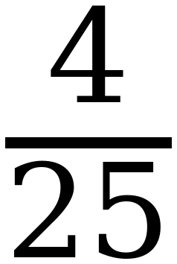
Example 1
The areas, checked.
Kind of number
Side s
Area s²
whole number
12 units
144
fraction
decimal
0.7 units
0.49
Grade 7 Accelerated · Unit 2 · Lesson 1 — Square Values
9

Slide 10
Example 1
Now backwards.
A square has an area of 2.25 square units.
What is the length of one side?
No guessing. Show me how you narrowed it down.
Grade 7 Accelerated · Unit 2 · Lesson 1 — Square Values
10

Slide 11
Example 1
Narrow it down.
Try
Try × Try
Compared with 2.25
1
1 × 1 = 1
too small
2
2 × 2 = 4
too big
?
? × ?
2.25 ✓
Grade 7 Accelerated · Unit 2 · Lesson 1 — Square Values
11

Slide 12
Example 1
The side.
1.5 × 1.5 = 2.25
The side is 1.5 units.
Grade 7 Accelerated · Unit 2 · Lesson 1 — Square Values
12

Slide 13
Example 2
Fill it in on your whiteboard. Seven values.
x
y = x²
−3
−2
−1
0
1
2
3
Grade 7 Accelerated · Unit 2 · Lesson 1 — Square Values
13

Slide 14
Example 2
The values.
x
y = x²
−3
9
−2
4
−1
1
0
0
1
1
2
4
3
9
Grade 7 Accelerated · Unit 2 · Lesson 1 — Square Values
14

Slide 15
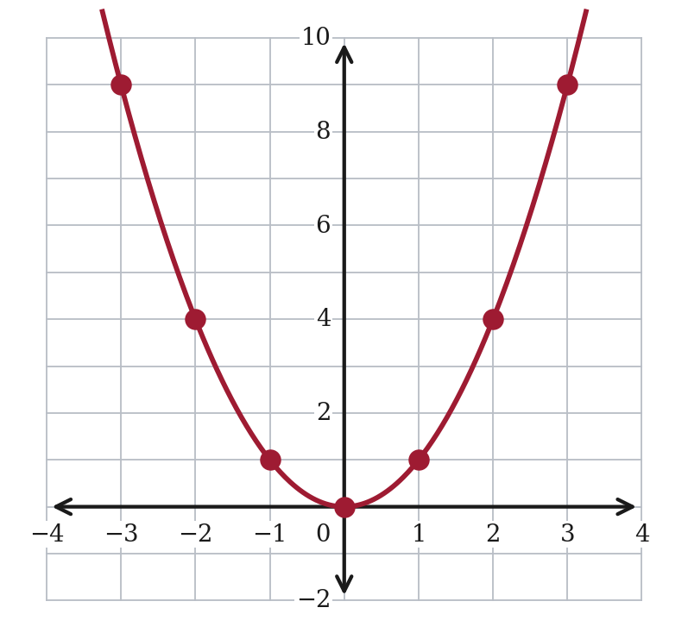
Example 2
Now the picture.
Grade 7 Accelerated · Unit 2 · Lesson 1 — Square Values
15

Slide 16
Example 3
The best question in this lesson.
Can a square have an area of 8 square units?
Yes or no, and how do you know?
Grade 7 Accelerated · Unit 2 · Lesson 1 — Square Values
16

Slide 17
Example 3
Every whole number, tried.
Side
Side × Side
Area
2
2 × 2
4 too small
3
3 × 3
9 too big
?
? × ?
8 ✓
So the side is between 2 and 3 — and it is not a whole number.
Grade 7 Accelerated · Unit 2 · Lesson 1 — Square Values
17

Slide 18
Example 3
And it is not a fraction either.
The side is about 2.83 — and that decimal never stops and never repeats.
Grade 7 Accelerated · Unit 2 · Lesson 1 — Square Values
18

Slide 19
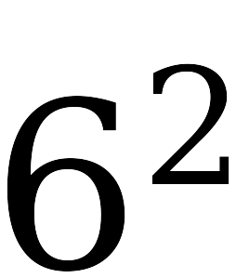
Whiteboards · Question 1 of 9
Boards up on three.
Write the value.
One number.
Grade 7 Accelerated · Unit 2 · Lesson 1 — Square Values
19

Slide 20
Whiteboards · Question 1 of 9
Answer.
6 × 6
Answer: 36
Grade 7 Accelerated · Unit 2 · Lesson 1 — Square Values
20

Slide 21
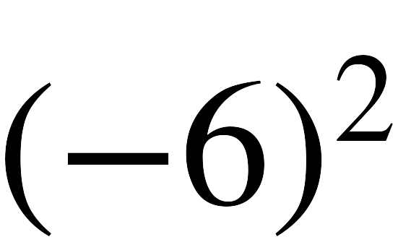
Whiteboards · Question 2 of 9
Boards up on three.
Write the value.
One number.
Grade 7 Accelerated · Unit 2 · Lesson 1 — Square Values
21

Slide 22
Whiteboards · Question 2 of 9
Answer.
(−6) × (−6)
Answer: 36
Grade 7 Accelerated · Unit 2 · Lesson 1 — Square Values
22

Slide 23
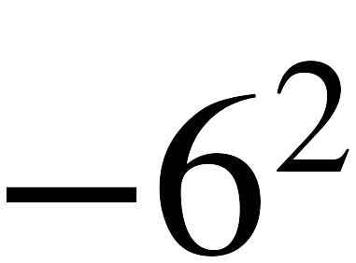
Whiteboards · Question 3 of 9
Boards up on three.
Write the value.
One number.
Grade 7 Accelerated · Unit 2 · Lesson 1 — Square Values
23

Slide 24
Whiteboards · Question 3 of 9
Answer.
−(6 × 6)
Answer: −36
Grade 7 Accelerated · Unit 2 · Lesson 1 — Square Values
24

Slide 25
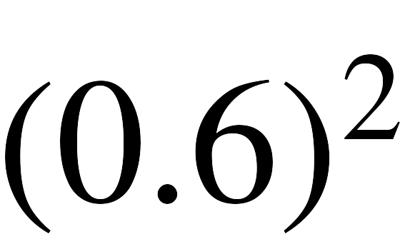
Whiteboards · Question 4 of 9
Boards up on three.
Write the value.
One number.
Grade 7 Accelerated · Unit 2 · Lesson 1 — Square Values
25

Slide 26
Whiteboards · Question 4 of 9
Answer.
0.6 × 0.6
Answer: 0.36
Grade 7 Accelerated · Unit 2 · Lesson 1 — Square Values
26

Slide 27
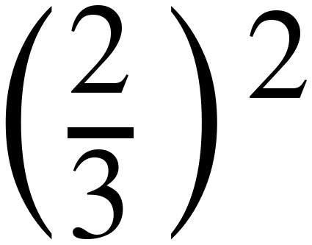
Whiteboards · Question 5 of 9
Boards up on three.
Write the value.
One number.
Grade 7 Accelerated · Unit 2 · Lesson 1 — Square Values
27

Slide 28
Whiteboards · Question 5 of 9
Answer.
square the top AND the bottom
Answer: 4/9
Grade 7 Accelerated · Unit 2 · Lesson 1 — Square Values
28

Slide 29
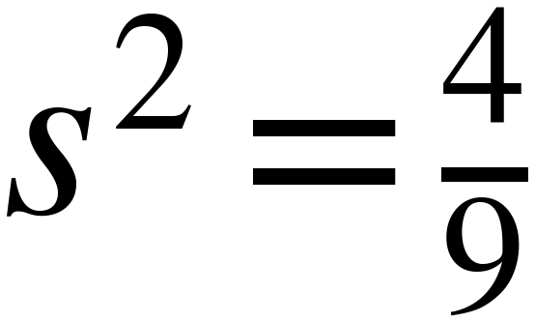
Whiteboards · Question 6 of 9
Boards up on three.
Write the side s.
A square has area 4/9 square units, and a side is a length.
Grade 7 Accelerated · Unit 2 · Lesson 1 — Square Values
29

Slide 30
Whiteboards · Question 6 of 9
Answer.
what times itself gives 4/9 ?
Answer: s = 2/3
Grade 7 Accelerated · Unit 2 · Lesson 1 — Square Values
30

Slide 31
Whiteboards · Question 7 of 9
Boards up on three.
Which is bigger: (−9)² or −9² ?
Write both values, then say which is bigger.
Two values and a comparison.
Grade 7 Accelerated · Unit 2 · Lesson 1 — Square Values
31

Slide 32
Whiteboards · Question 7 of 9
Answer.
Which is bigger: (−9)² or −9² ?
(−9)² = 81 −9² = −81
Answer: (−9)² is bigger
Grade 7 Accelerated · Unit 2 · Lesson 1 — Square Values
32

Slide 33
Whiteboards · Question 8 of 9
Boards up on three.
1 8 16 20 45 64
Which of these are perfect squares? Write every one that is.
There is more than one.
Grade 7 Accelerated · Unit 2 · Lesson 1 — Square Values
33

Slide 34
Whiteboards · Question 8 of 9
Answer.
1 8 16 20 45 64
1 = 1 × 1 16 = 4 × 4 64 = 8 × 8
Answer: 1, 16 and 64
Grade 7 Accelerated · Unit 2 · Lesson 1 — Square Values
34

Slide 35
Whiteboards · Question 9 of 9
Take your time. Boards up when you have written it.
Can a square have an area of 8 square units? If it can, name the two whole numbers its side length falls between. Explain how you know.
Write your answer in sentences.
This one is written work. Show the two products you used.
Grade 7 Accelerated · Unit 2 · Lesson 1 — Square Values
35

Slide 36
Whiteboards · Question 9 of 9
Answer.
Can a square have an area of 8 square units? If it can, name the two whole numbers its side length falls between. Explain how you know.
2 × 2 = 4 is too small; 3 × 3 = 9 is too big
Answer: Yes — the side is between 2 and 3
Grade 7 Accelerated · Unit 2 · Lesson 1 — Square Values
36

Slide 37
IXL
Last five minutes.
1.
Open IXL and start today's skills.
2.
Work on paper where the question needs work. The answer box does not show it.
3.
Whatever you do not finish is tonight's practice.
4.
The skills for today are posted in Google Classroom.
Grade 7 Accelerated · Unit 2 · Lesson 1 — Square Values
37

